Slide 1
Intelligent Baby Monitoring
Khan Muhammad
Department of Applied AI
Sungkyunkwan University, Seoul, Republic of Korea
Email: khan.muhammad@ieee.org

Slide 2
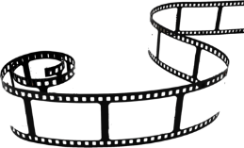

INDEX
Main Contents
Introduction
Data collection
Implemented methods
Results and discussion
Baby behavior analysis patent
Conclusion and future directions

Slide 3
INDEX
01
1. Introduction
Motivation
Challenges in possible baby monitoring methods

Slide 4
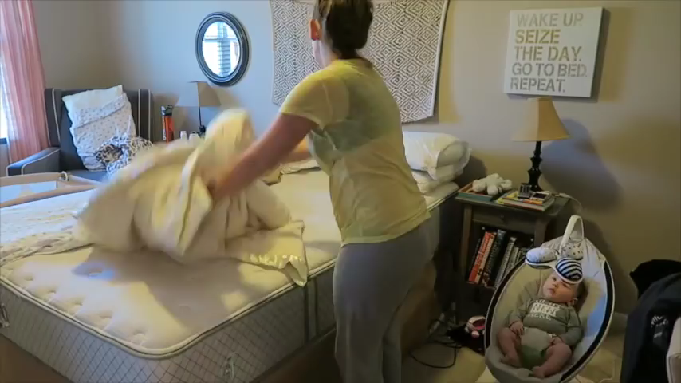
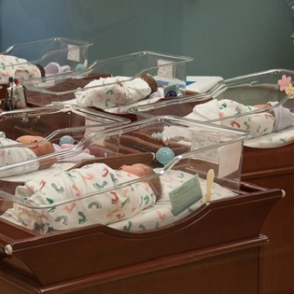
i. Motivation
There are many nurseries with strangers spying on babies.
These strangers may be careless about the babies.
On the other hand, while keeping baby in house, doing house chores and monitoring baby becomes very difficult.
Babies in nurseries
Video: Doing house chores and monitoring baby

Slide 5
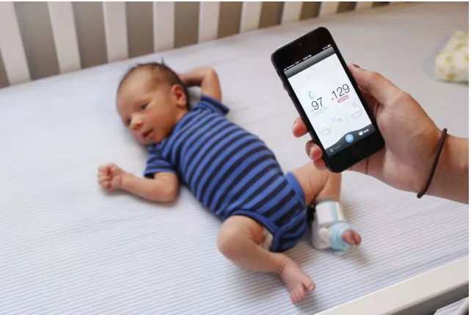
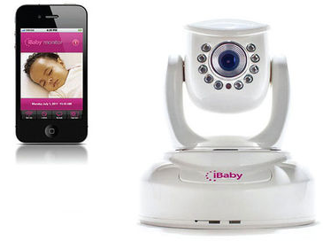
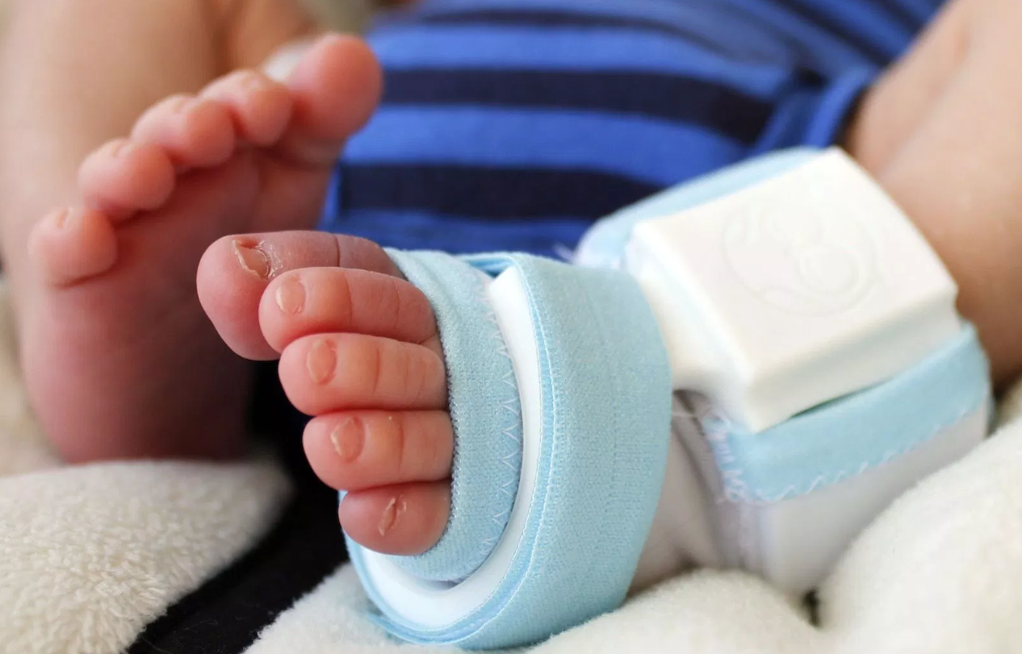
ii. Challenges in possible baby monitoring methods
1. Monitoring through sensors
2. Monitoring through camera
Often babies are paranoid towards sensors.
Babies do not leave sensor on their chest or hands for monitoring purposes.
It is very hard and challenging to detect motion or breathing of the baby through image processing techniques.
When baby breathes it is very slight amount of motion to detect from camera.
Monitoring baby through sensor in his foot
Monitoring baby through camera

Slide 6
INDEX
02
2. Data collection
Why creating dataset?
Description of dataset

Slide 7
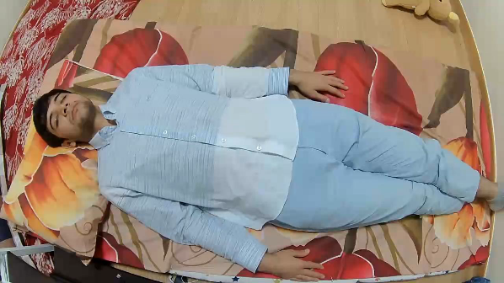
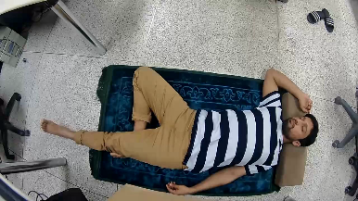
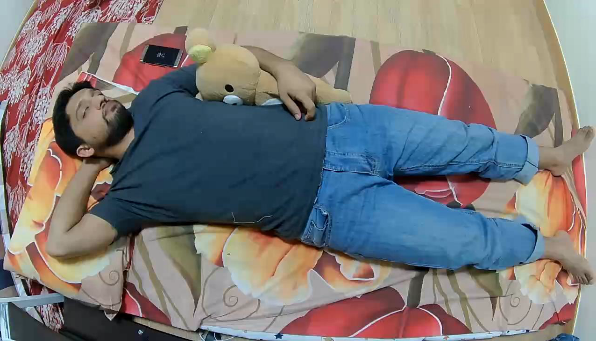
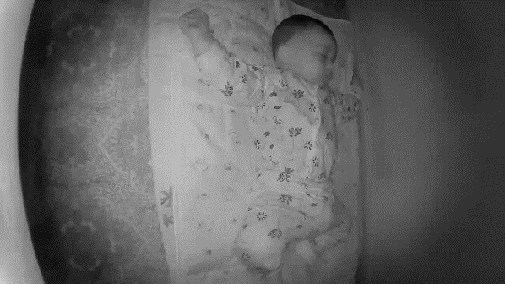
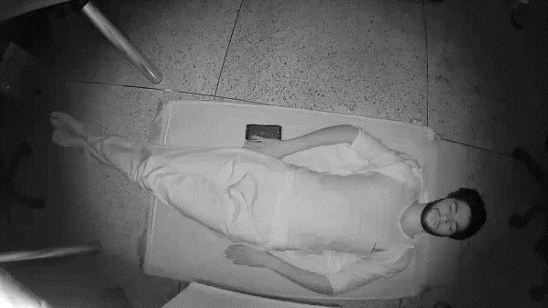
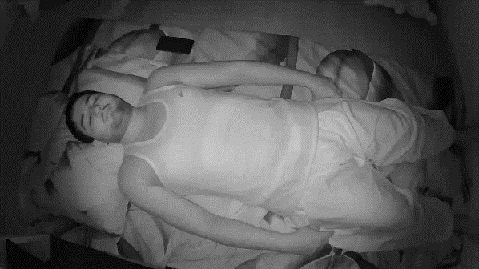
i. Why creating dataset?
The dataset is created because there are no available benchmark datasets for baby monitoring.
Thus, data is insufficient to make and validate experiments for baby monitoring application.
(a)
(b)
Sample images of dataset at three different scenarios with four different altitudes

Slide 8
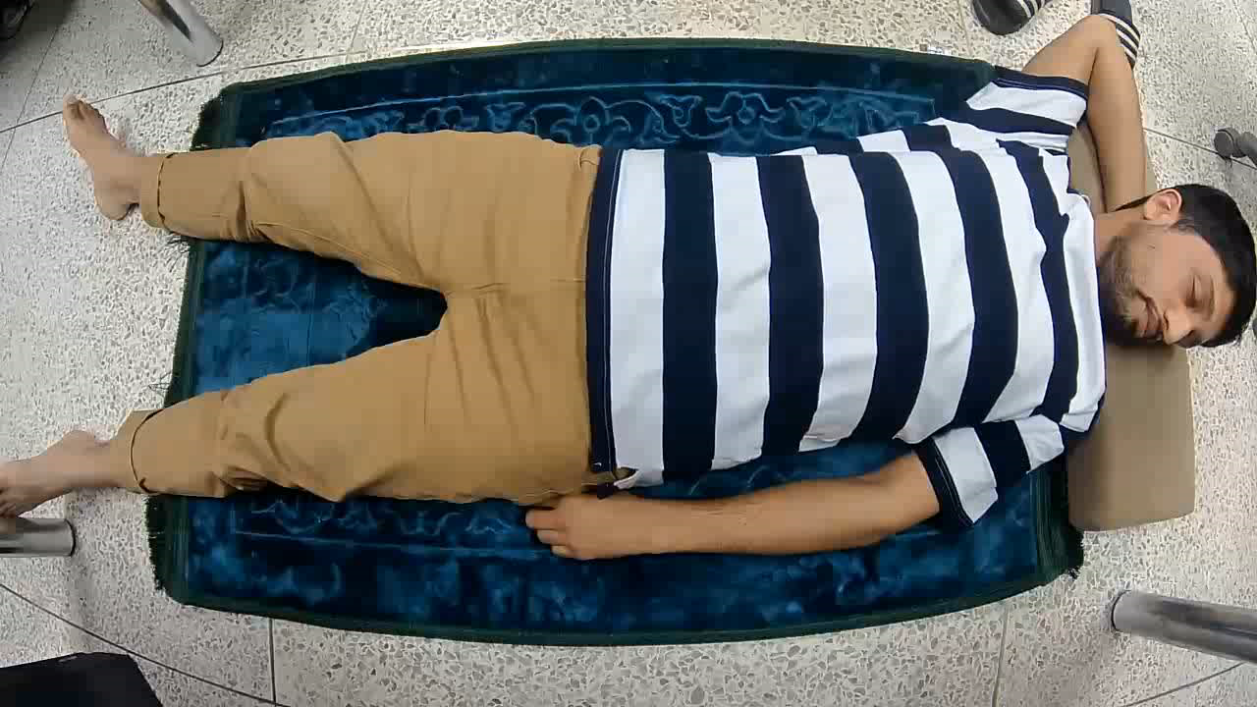

ii. Description of dataset
The dataset consists of 27 videos.
Data is collected in three different scenarios.
There are various poses during sleep made by the
subjects.
Height range varies from 65-cm to 108-cm.
There are total 6 subjects in the dataset.
Overall details of dataset
Total videos | 27
Total height ranges | 4
Total Subjects | 6
(a). Sample adult video with 108-cm height
(b). Sample baby video with 65-cm height

Slide 9
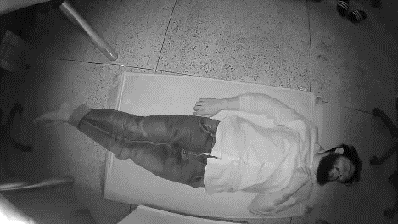
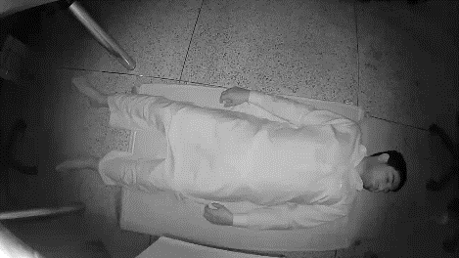
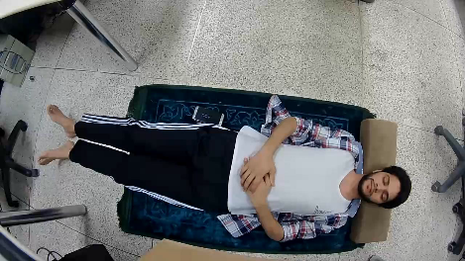

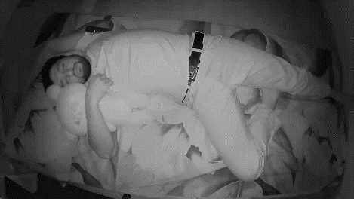
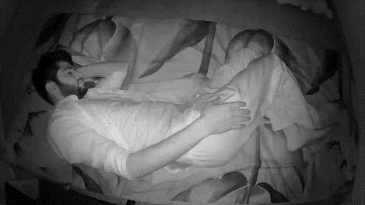
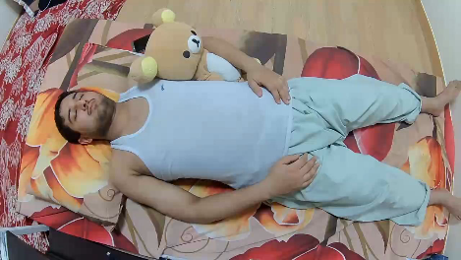

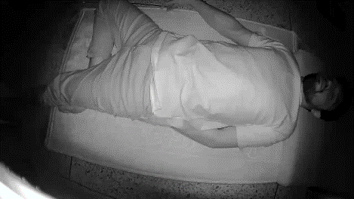
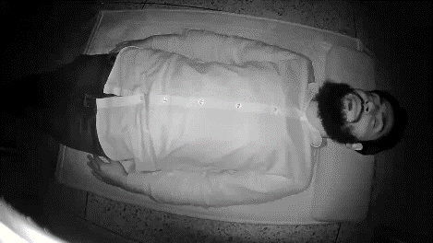
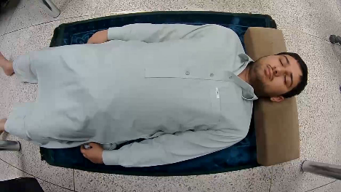
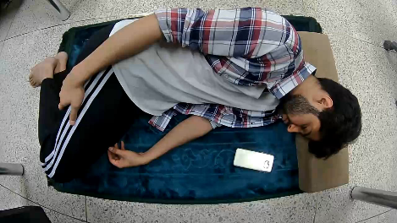

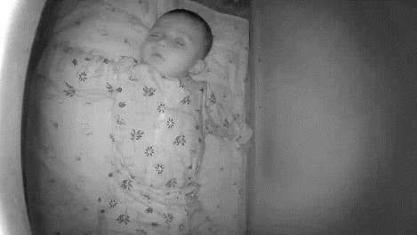
ii. Description of dataset
Height
(108-cm)
Subject-4
Subject-2
Subject-1
Subject-3
Height
(90-cm)
Subject-3
Subject-1
Subject-2
Subject-5
Height
(74-cm)
Subject-3
Subject-4
Subject-2
Subject-1
Height
(65-cm)
Subject-6
Subject-6

Slide 10
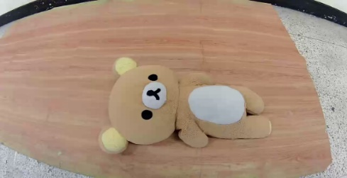
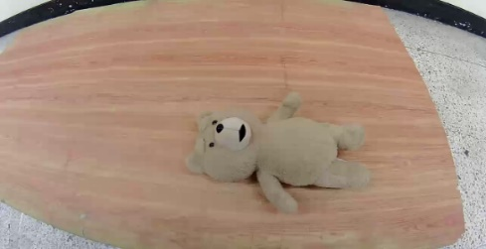
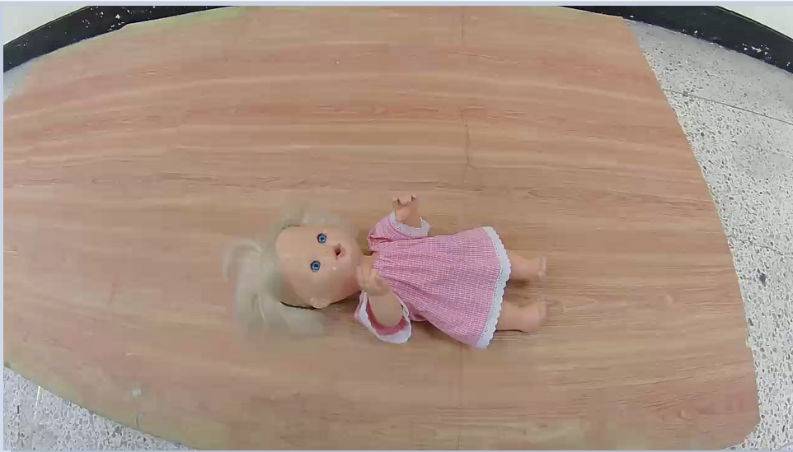
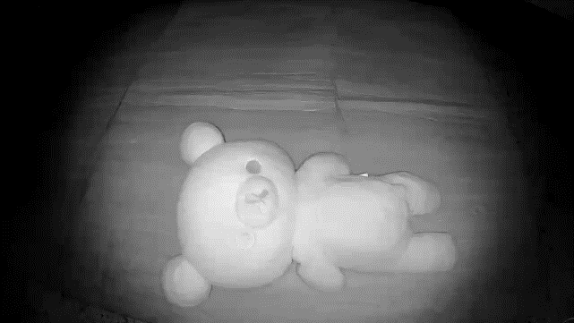
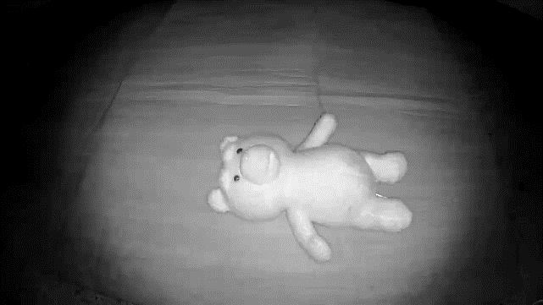
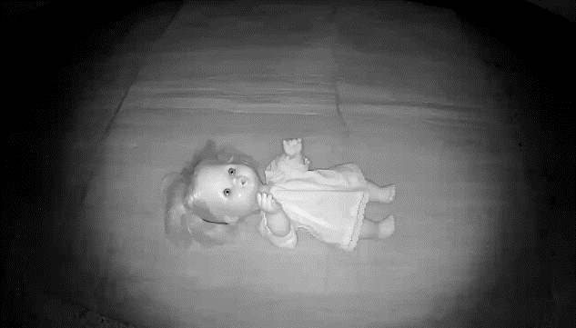
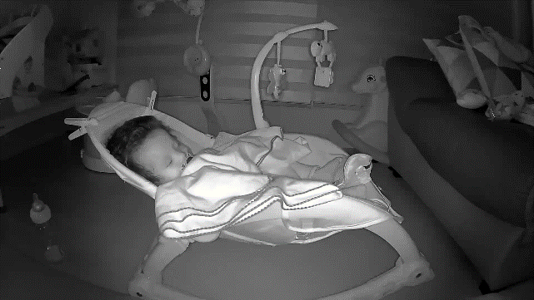
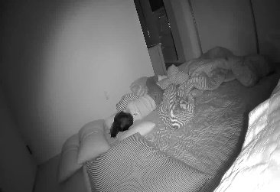
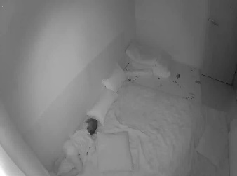
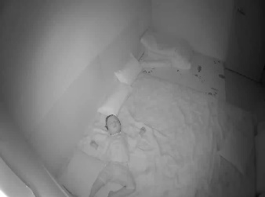
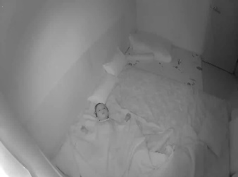
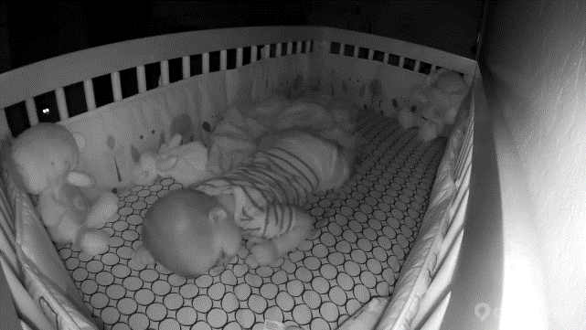
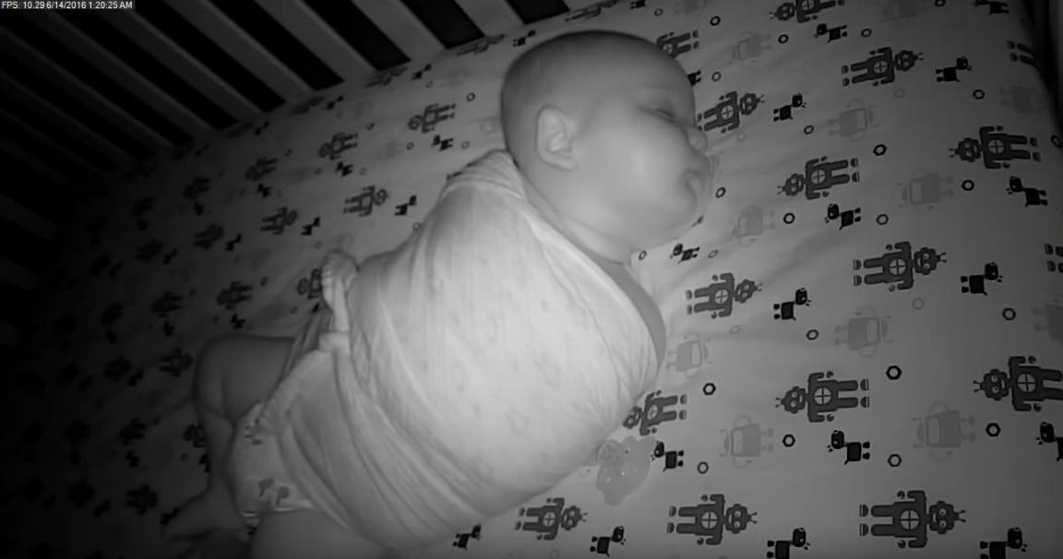
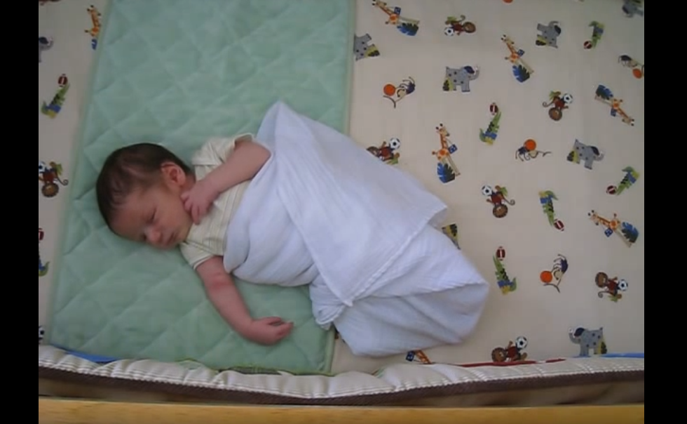
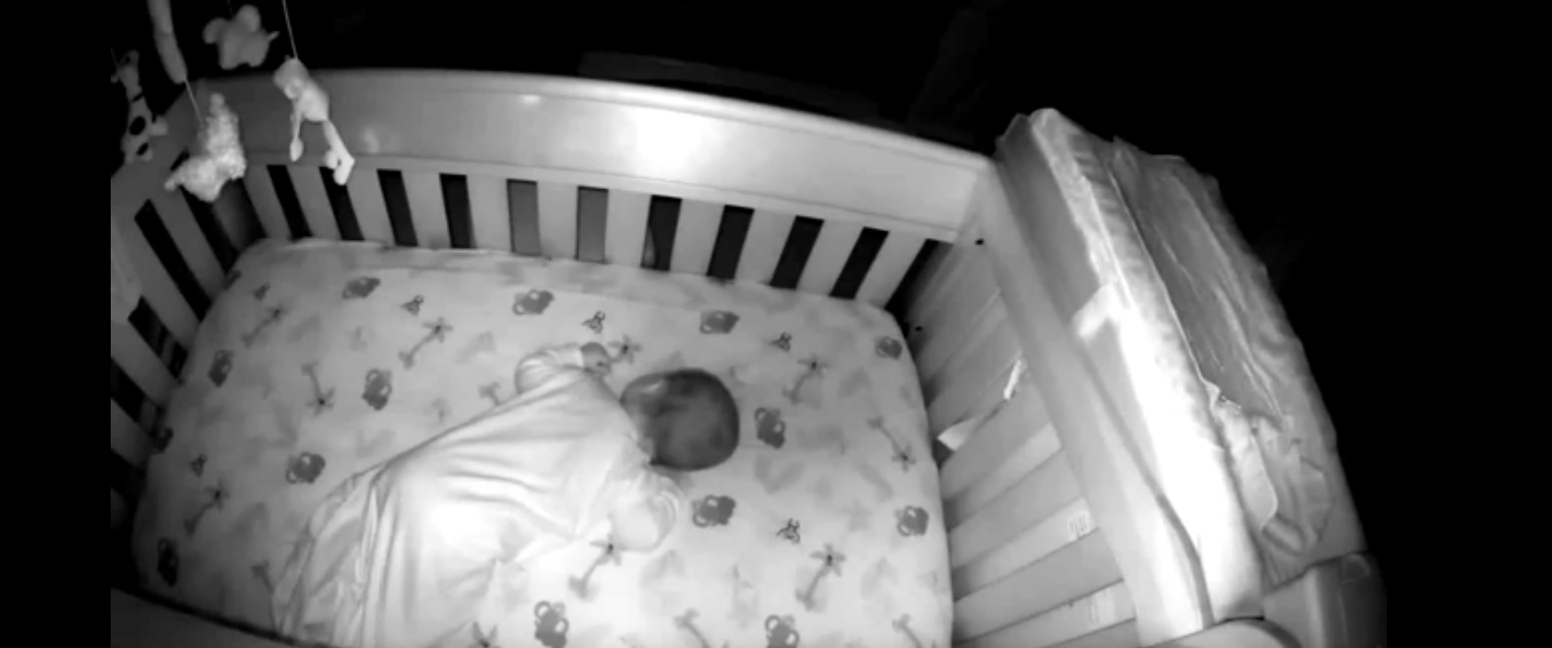
ii. Description of dataset
Object size
Large
Medium
Small
Static object
videos
Company
videos
YouTube
videos

Slide 11
INDEX
03
3. Implemented methods
Frame difference
Optical flow
Background subtraction
Hybrid method

Slide 12
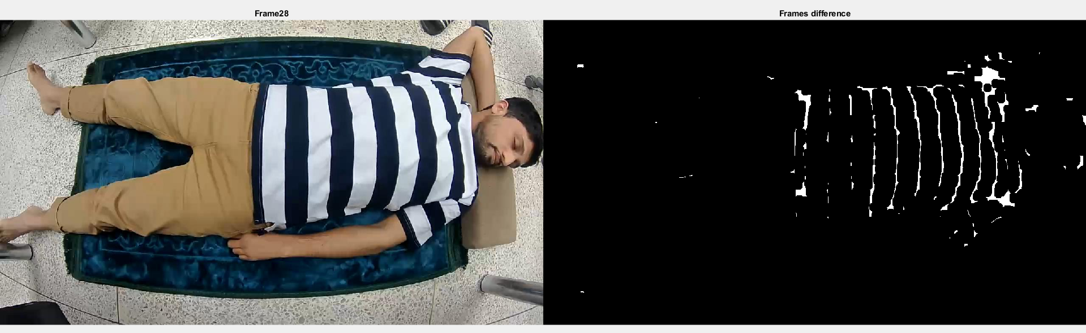
i. Frame difference
In this method, motion inside video is detected through the frame difference between consecutive frames.
In frames difference method, pixel difference between frames is considered to detect the motion present in video.
Frame difference between two consecutive frames
Figure shows the estimated change between two consecutive frames.

Slide 13
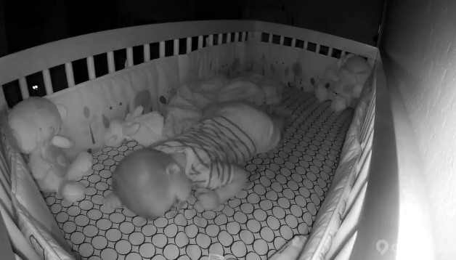
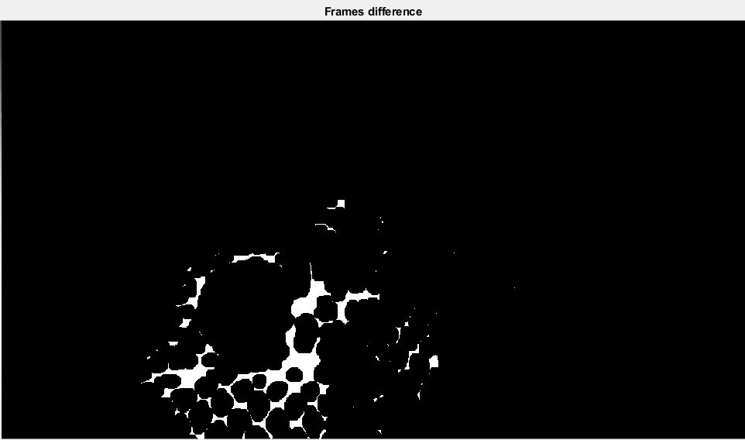
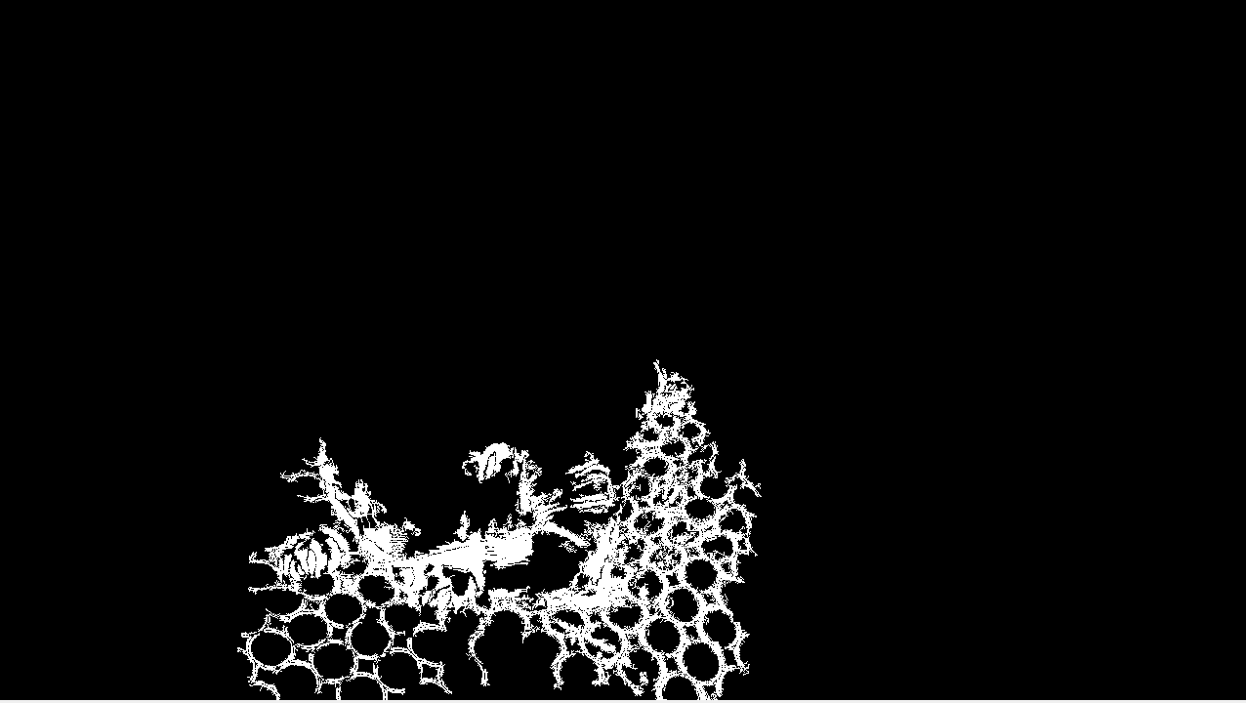
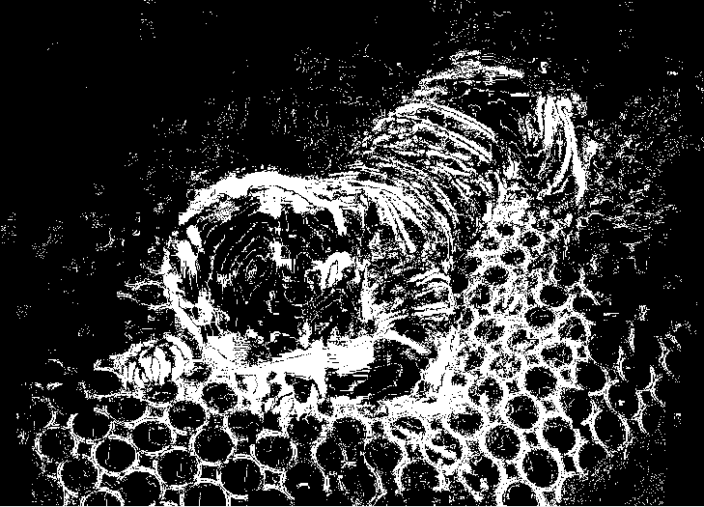
i. Frame difference framework
This method comprises of the following steps:
  Calculate pixel wise difference between two successive frames.
  Convert the difference image into binary.
  Compute binary image to detect motion.
1
Pixel value >
max/(max*0.5)
Input Video
Consecutive
Frames
Frames Absolute
Difference
2
Threshold Based Motion Area
Selection
Morphological
operations
Motion area
Binary Image
3

Slide 14
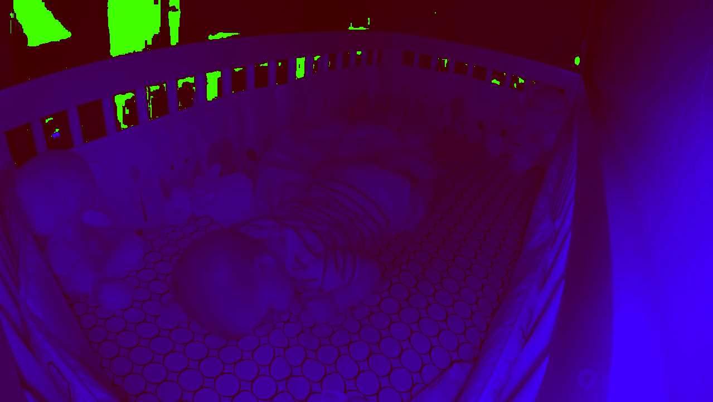
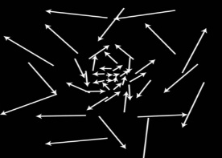
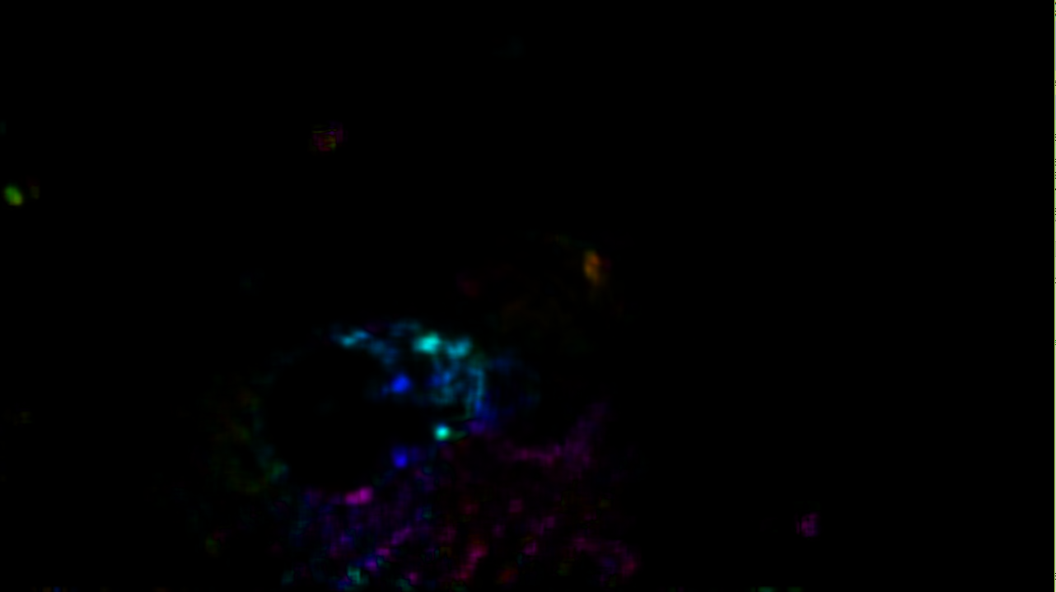
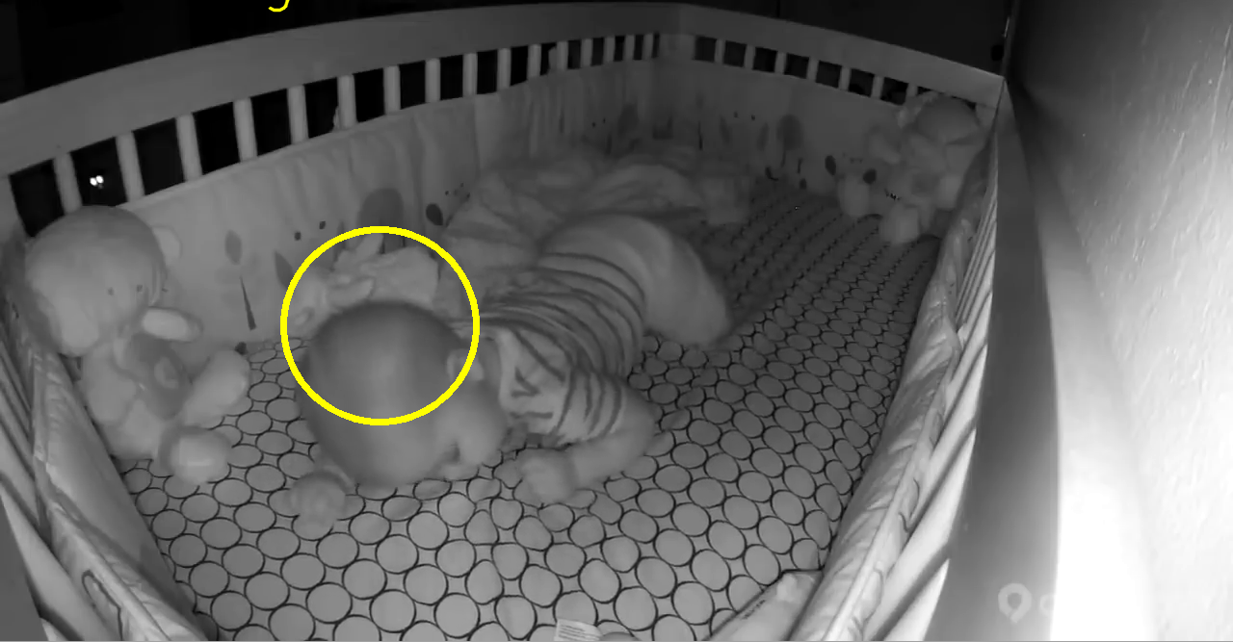
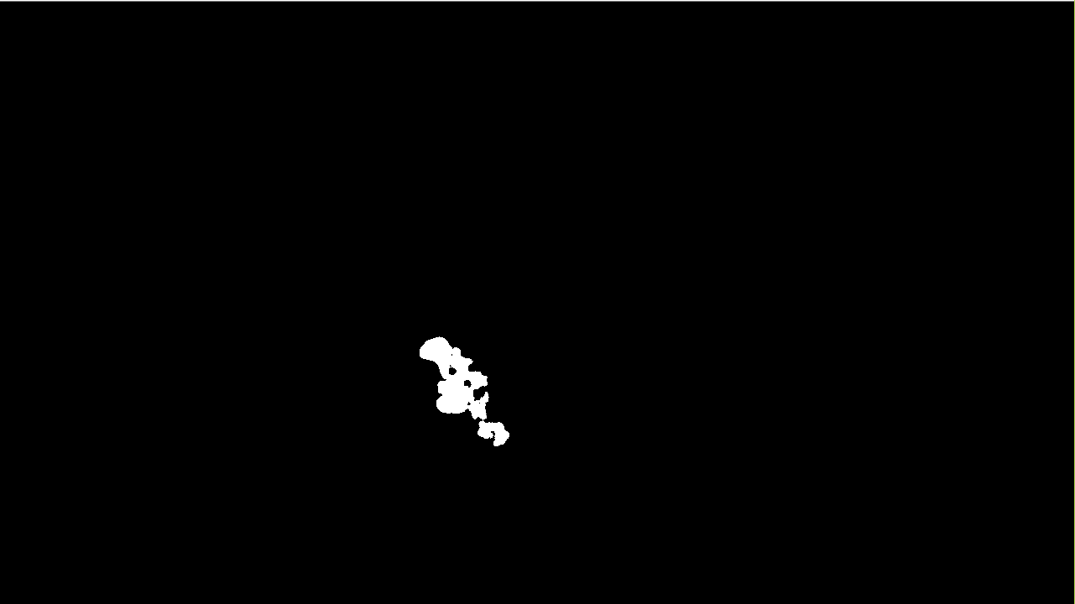
ii. Optical flow based motion estimation framework
Motion estimation with optical flow
  Optical flow motion detection technique is used to estimate the motion in each frame of video sequence.
  Consecutive frames at time (t, t + 1) are converted into HSI color model.
  These frames are input to optical flow algorithm which detects the flow.
  Flow is converted into binary, and maximum flow region inside binary image is encircled.
Frame i
Frame i
Input Video
Frame i+1
Frame i+1
Optical flow
algorithm
Detected flow
Consecutive frames
RGB to HSI
Compute maximum
flow regions
Output results
Estimated motion in binary

Slide 15

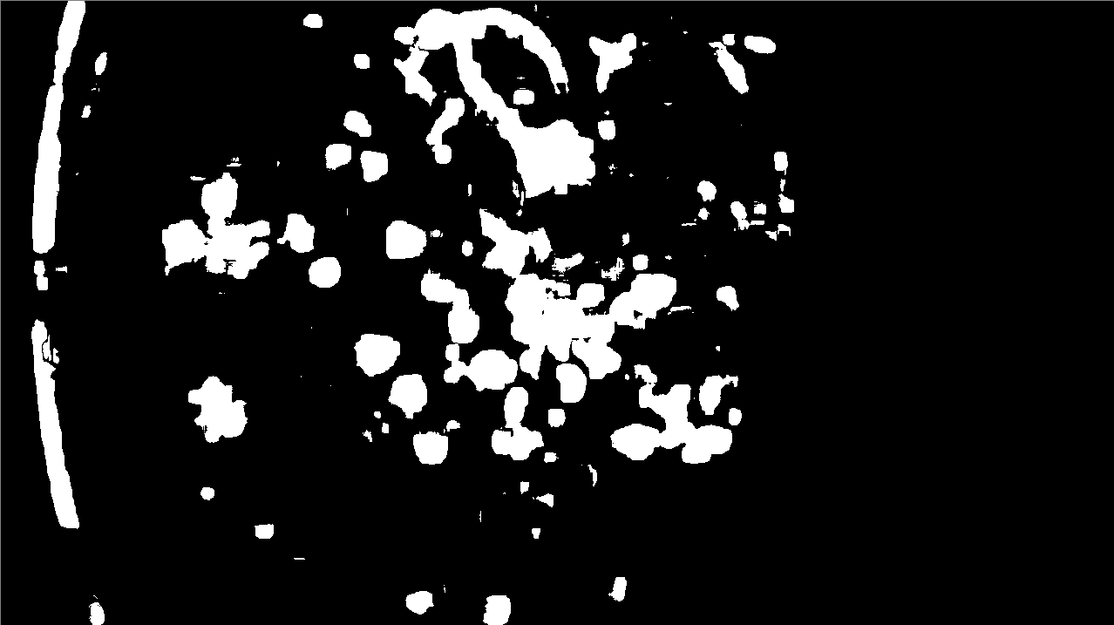

iii. Background subtraction
Background subtraction is a technique used for generating a foreground mask by using static cameras.
Foreground mask is a binary image containing the pixels that belong to moving objects in the scene.
Background subtraction algorithm calculates the foreground mask by performing a subtraction between the current frame and a background model.
Threshold
Frame i
Background model
Input Video
Foreground mask
(motion area)
Frame i+1
Consecutive frames
Current frame
Calculate maximum
difference region
Working of background selection algorithm
Output

Slide 16



iv. Hybrid method
$$+\frac{n\left(n−1Optjfskljafkdljasdjfkljas\right)x^{2}}{2!}+…$$
$$Pixel value>\frac{max}{max∗0.5}$$
Intersection
Consecutive Frames
Absolute difference
Estimated motion in binary
Frame difference
Optical flow
algorithm
Input Video
RGB to HSI
Flow image
Estimated motion in binary
Optical flow
Threshold
Final estimated
motion
Current frame
Background
subtraction
If area >= 50, confidence = 100%
Between 40&50,confidence=95%
Between 30&40,confidence=90%
Area < 20, confidence = 80%
Subtracted image
Estimated motion in binary
Background model
Compute area of motion
Final output

Slide 17
iv. Hybrid method
$$+\frac{n\left(n−1Optjfskljafkdljasdjfkljas\right)x^{2}}{2!}+…$$
$$Pixel value>\frac{max}{max∗0.5}$$
Intersection
Consecutive Frames
Absolute difference
Estimated motion in binary
Frame difference
Optical flow
algorithm
Input Video
RGB to HSI
Flow image
Estimated motion in binary
Optical flow
Threshold
Final estimated
motion
Current frame
Background
subtraction
Match with expert data and draw ellipses
Subtracted image
Estimated motion in binary
Background model
Breathing, Confidence = 100%
Final output

Slide 18
INDEX
04
4. Results and discussion
Performance evaluation
Experimental results

Slide 19

i. Performance evaluation
GT
Correct Frames Prediction
Accuracy of Different Methods
No. | Total Frames
1 | 2710
2 | 1111
3 | 3597
4 | 1690
5 | 2864
Frame Difference | Optical Flow | Background Subtraction | Hybrid
2378 | 2379 | 2447 | 2541
994 | 981 | 1020 | 1068
3267 | 3203 | 3298 | 3540
910 | 1411 | 1210 | 1522
2386 | 2606 | 2539 | 2648
Frame Difference | Optical Flow | Background Subtraction | Hybrid | Remarks
87.77% | 87.81% | 90.30% | 93.76% | Our dataset
89.43% | 88.26% | 91.77% | 96.12% | Our dataset
90.84% | 89.05% | 91.70% | 98.42% | Our dataset
84.61% | 94.49% | 90.53% | 96.68% | Our dataset
83.31% | 90.99% | 88.65% | 92.48% | Our dataset
$$Accuracy =\frac{Total Number of Correctly Predicted Frames}{Total Number of Frames}$$

Slide 20
i. Performance evaluation
GT
Correct Frames Prediction
Accuracy of Different Methods
No. | Total Frames
6 | 2646
7 | 1859
8 | 808
9 | 1247
10 | 1854
11 | 2363
Frame Difference | Optical Flow | Background Subtraction | Hybrid
1987 | 1869 | 2368 | 2597
1543 | 1446 | 1809 | 1859
580 | 629 | 804 | 808
919 | 991 | 1238 | 1247
1775 | 1809 | 1802 | 1830
2009 | 2175 | 2238 | 2282
Frame Difference | Optical Flow | Background Subtraction | Hybrid | Remarks
75.09% | 70.63% | 89.50% | 98.14% | Our dataset
82.98% | 77.78% | 97.32% | 100% | Our dataset
71.74% | 77.80% | 99.58% | 100% | Our dataset
73.72% | 79.49% | 99.33% | 100% | Our dataset
95.75% | 97.59% | 97.23% | 98.70% | Company video
85.09% | 92.05% | 94.72% | 96.57% | YouTube video

Slide 21

ii. Experimental results (Video 1)
Experimental results of Hybrid method, height ( 90-cm ), subject 1

Slide 22

ii. Experimental results (Video 2)
Experimental results of Hybrid method, height ( 90-cm ), subject 3

Slide 23

ii. Experimental results (Video 3)
Experimental results of Hybrid method, height ( 65-cm ), subject 6

Slide 24

ii. Experimental results (Video 4)
Experimental results of Hybrid method, height ( 90-cm ), subject 1

Slide 25

ii. Experimental results (Video 5)
Experimental results of Hybrid method, height ( 90-cm ), subject 2

Slide 26

ii. Experimental results (Video 6)
Experimental results of Hybrid method, height (N/A), subject doll 1

Slide 27

ii. Experimental results (Video 7)
Experimental results of Hybrid method, height (N/A), subject doll 2

Slide 28

ii. Experimental results (Video 8)
Experimental results of Hybrid method, height (N/A), subject doll 3

Slide 29

ii. Experimental results (Video 9)
Experimental results of Hybrid method, height (N/A), subject doll 1

Slide 30

ii. Experimental results (Video 10)
Experimental results of Hybrid method, height ( N/A )

Slide 31

ii. Experimental results (Video 11)
Experimental results of Hybrid method, height ( N/A )

Slide 32
INDEX
5. Baby behavior analysis patent
05
System diagram
Working of the proposed system
Overall framework
Control chart representation
Control charts for intervals
Control chart representation in terms of time
Motion estimation mechanism
Baby behavior estimation mechanism
Standard baby size chart

Slide 33
i. System diagram
Apparatus and method for analyzing baby behavior
Intervals processing module
Instant reporting module
Interval selection unit
Alert sensing unit
Baby detection and segmentation unit
Alert notification unit
Baby motion detection module
Motion features extraction unit
Baby behavior analysis module
Motion assessment unit
Control charts construction unit
Expert data matching unit
Baby behavior assessment unit
Ellipse drawing unit

Slide 34
ii. Working of the proposed system
Information sharing
6
If the behavior of the baby is abnormal,
parents are notified immediately
Behavior analysis
5
Behavior is analyzed from the
constructed control chart
Control chart
construction
4
Control chart is constructed
corresponding to the motion of baby
Baby movement
detection
3
In each interval baby
motion area is analyzed, and ellipse(s) is/are drawn
Intervals
2
Video is divided into different intervals
Input video
1
Input video is
acquired from
camera

Slide 35




iii. Overall framework
Compute frame
to baby ratio
Baby segmentation from background
Input video
Information about how far is baby
from camera
Each ellipse cannot
exceed any body
part size
Match with
expert data
Compute
motion area
Expert knowledge
about size of baby parts [1]
Number of ellipses
represents diversity
of motion
Size of ellipses represents intensity of motion
10
8
6
UCL
Movement Intensity
4
2
LCL
0.2
1
2
3
4
5
Movement Diversity

Slide 36
iv. Control chart representation
This whole chart represents the motion behavior of baby for a single interval
These points are plotted based on motion difference between two consecutive frames of an interval
UCL limit is crossed, so parents are notified about abnormal behavior of the baby
LCL
UCL
10
Symbol | Frame in Interval
 | 1st
 | 2nd
 | 3rd
 | 4th
 | 5th
8
Movement Intensity
UCL
6
4
2
UCL: Upper control limit
LCL: Lower control limit
0.2
LCL
0
1
2
3
4
5
Movement Diversity
LCL limit is crossed, as there is no motion of the baby so
parents are notified about
abnormal behavior of the baby

Slide 37






















v. Control charts for intervals
Sign
Frame | 1st | 2nd | 3rd | 4th | 5th
10
8
6
Movement Intensity
4
2
Interval 1
0.2
1
2
3
4
5
Movement Diversity
10
8
6
Movement Intensity
4
Interval 2
2
0.2
1
2
3
4
5
Movement Diversity
Input video
10
8
6
Movement Intensity
4
2
Interval 3
0.2
1
2
3
4
5
Movement Diversity
10
8
6
Movement Intensity
4
Interval 4
2
0.2
1
2
3
4
5
Movement Diversity

Slide 38

vi. Control chart representation in terms of time
Representation | X-axis | Y-axis | Z-axis | T | I | D
Description | Intensity | Time | Diversity | Time | Intensity | Diversity
Diversity and Intensity < LCL
Intensity > UCL
Diversity and Intensity > UCL
UCL
(T=5, I=7, D=5)
(T=3, I=4, D=3)
(T=4, I=7, D=4)
Diversity
(T=2, I=3, D=1)
Normal
LCL
(T=1, I=0, D=0)
LCL
UCL
Intensity
Time

Slide 39
vii. Motion estimation mechanism
Start
Input video
Process next consecutive frames
Two consecutive frames
Absolute difference
computation
Remove noise
Background subtraction
Thresholding on calculated
difference image
Optical flow algorithm
Thresholding on subtracted
image
Binary motion estimation
Binary motion estimation
from optical flow
Binary motion estimation
Binary images integration
Last
frame?
No
Final motion computation
Yes
End

Slide 40
viii. Baby behavior estimation mechanism
Start
Input video
Process next interval
UCL: Upper control limit
LCL: Lower control limit
I = Intensity
D = diversity
Select interval
Compute motion through motion estimation mechanism
Draw ellipse(s) on all frames of single interval
Construct control chart using ellipse(s) [I and D]
Report instantly to
parents for abnormal
behavior of baby
I < LCL OR I > UCL?
OR
D < LCL OR D > UCL?
Normal behavior
Yes
No
Last
interval?
No
Yes
End

Slide 41
ix. Standard baby size chart [1]
Age (months) Body parts | 3 | 6 | 12 | 18 | 24
 | Baby size in cm
Chest | 40.5 | 43 | 45.5 | 48 | 50.5
Center back (Neck-to-Wrist) | 26.5 | 29 | 31.5 | 35.5 | 45.5
Back waist (length) | 15.5 | 17.5 | 19 | 20.5 | 21.5
Cross back (Shoulder to shoulder) | 18.5 | 19.5 | 21 | 21.5 | 22
Arm length (To underarm) | 15.5 | 16.5 | 19 | 20.5 | 21.5
Upper arm | 14 | 15.5 | 16.5 | 17.5 | 19
Armhole depth | 8.5 | 9 | 9.5 | 10 | 10.5
Waist | 15.5 | 48 | 50.5 | 52 | 53.5
Hips | 48 | 50.5 | 50.5 | 53.5 | 56

Slide 42
INDEX
06
6. Conclusion and future directions

Slide 43
6. Conclusion and future directions
Challenges of baby monitoring application are highlighted.
Videos dataset is created, having 27 videos.
Four different motion detection methods are implemented and their performance using the dataset is investigated.
Frame difference-based method has worst results while optical flow method shows average results.
Hybrid method is best and recommended for baby monitoring as verified from experiments.
Detailed behavior analysis of baby based on the motion of baby.
Future work will focus on extension of dataset in terms of number of videos, scenarios, and challenges.
The hybrid method is comparatively computationally expensive.

Slide 44
References
https://www.craftyarncouncil.com/standards/baby-size-chart
(Accessed: 14 March 2026, 9:25 AM)
https://docs.opencv.org/3.4/d7/d8b/tutorial_py_lucas_kanade.html
(Accessed: 14 March 2026, 9:26 AM)
3. https://docs.opencv.org/3.4/db/d5c/tutorial_py_bg_subtraction.html
(Accessed: 14 March 2026, 9:27 AM)
J. Lim and B. Han, "Generalized Background Subtraction Using Superpixels with Label Integrated Motion Estimation," in Computer Vision – ECCV 2014, Cham,
2014, pp. 173-187.
Michael W. Tao, Jiamin Bai, Pushmeet Kohli, and Sylvain Paris.
"SimpleFlow: A Non-I terative, Sublinear Optical Flow Algorithm". Computer
Graphics Forum (Eurographics 2012), 31(2), May 2012.
6. Method and system for analyzing baby behavior (아기 행동 분석 시스템 및 그 방법)
7. Hussain, T., Muhammad, K., Khan, S., Ullah, A., Lee, M. Y., & Baik, S. W. (2019).
Intelligent baby behavior monitoring using embedded vision in IoT for smart healthcare centers. Journal of Artificial Intelligence and Systems, 1(1), 110-124.

Slide 45






Thank you
Q&A
45

